Slide 1


Exploratory Data Analysis of NYC Airbnb
Dive into the diverse Airbnb market in New York City through a comprehensive data analysis.
by Yashwanth Reddy Boddireddy

Slide 2

Introduction
Dataset Overview
Purpose of Analysis
The dataset is sourced from the official NYC Airbnb listings, comprising detailed information on property attributes, pricing, location, and reviews. Its relevance lies in understanding the key factors driving the Airbnb market in NYC and guiding strategic decisions.
This analysis aims to uncover insights and trends within the NYC Airbnb market, providing valuable information for hosts, guests, and potential investors. It will delve into pricing dynamics, popular locations, and the impact of various variables on listing popularity.

Slide 3

Data Cleaning and Preparation
1
Handling Missing Values
2
Filling in Gaps
Replaced missing names and host names with "Unknown".
Filled in last review dates and reviews per month.
3
Ensuring Integrity
No duplicates found in the 48,895 listings.

Slide 4
Descriptive Statistics
Pricing Insights
Minimum Nights
Average price $153, with a wide range from $0 to $10,000.
Average 7 nights, but up to 1,250 nights required.
Review Patterns
Availability
Average 23 reviews, with a max of 629 reviews.
Listings available 113 days on average, ranging 0 to 365 days.

Slide 5
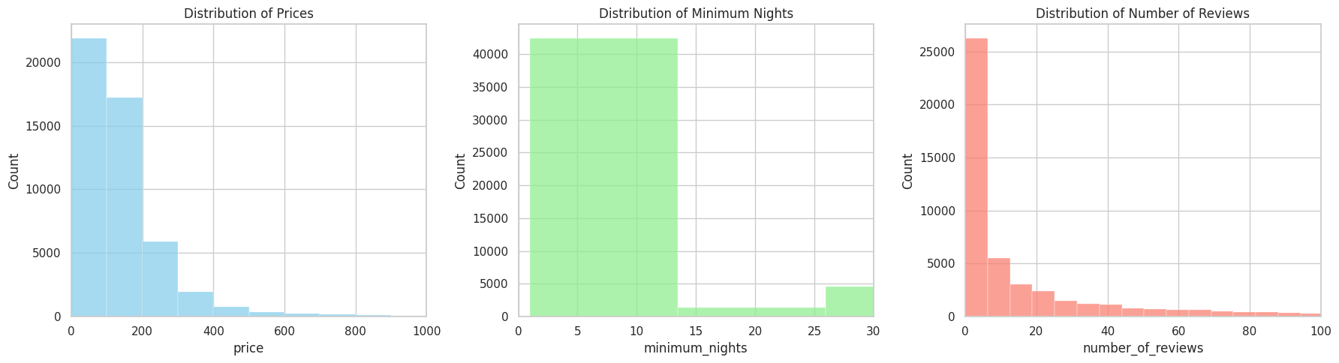
Univariate Analysis
Pricing
Minimum Nights
Reviews
Majority of listings under $250, with few high-priced outliers.
Most listings require fewer than 5 nights, with some long-term stays.
Many listings have under 20 reviews, indicating varied popularity.

Slide 6
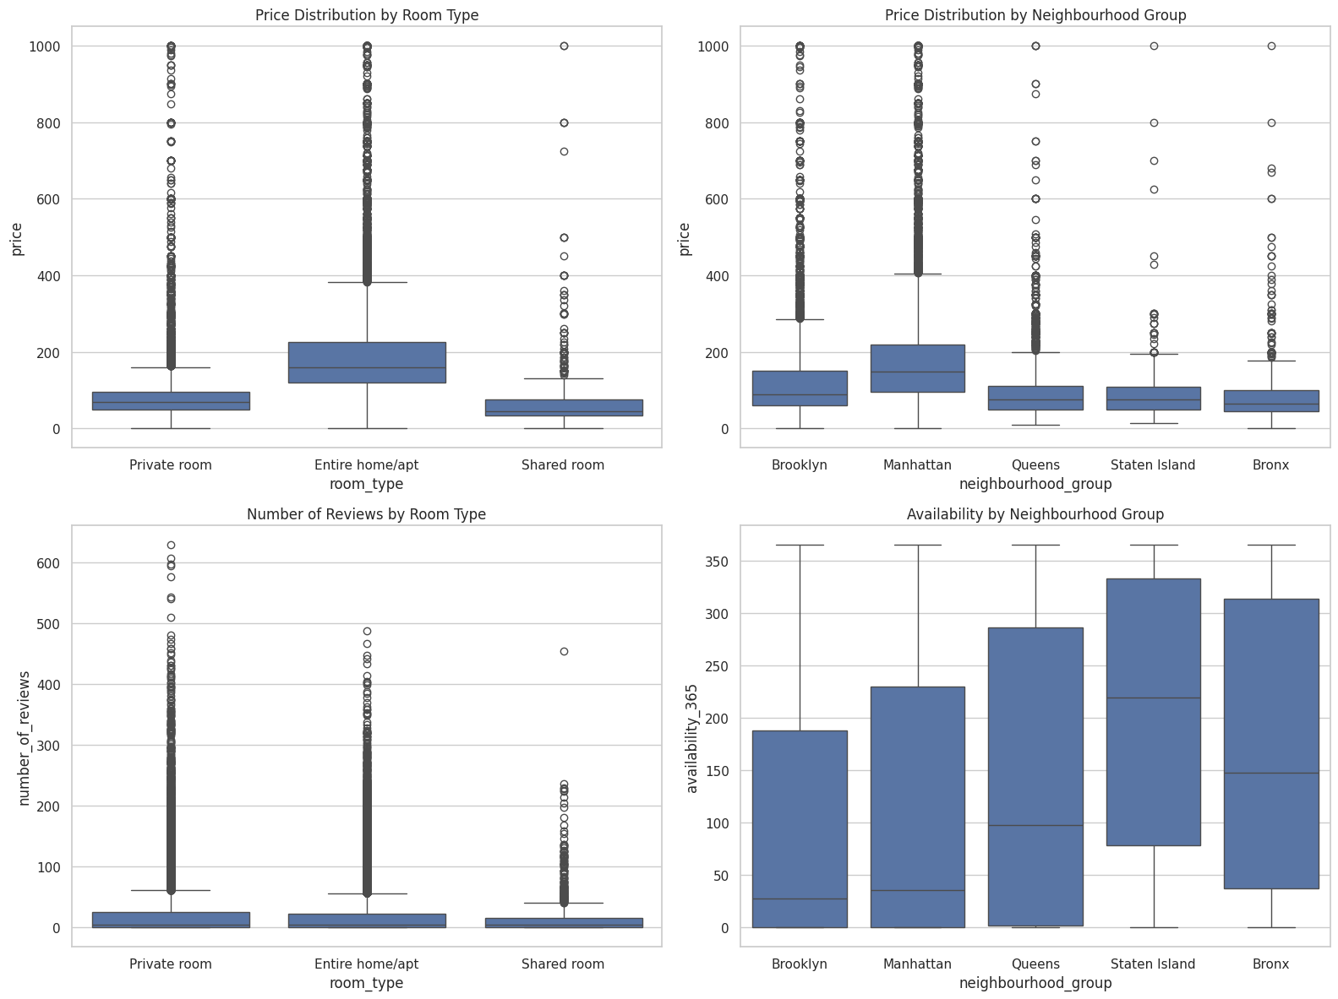
Bivariate Analysis
Price by Room Type
Price by Location
Reviews by Room Type
Entire homes most expensive, followed by private and shared rooms.
Manhattan most expensive, Staten Island and Bronx most affordable.
Private rooms and entire homes have more reviews than shared rooms.

Slide 7
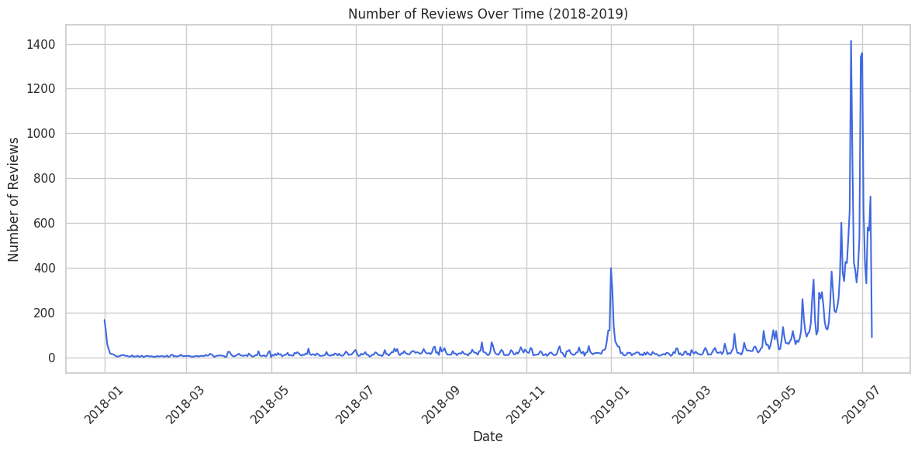
Temporal Analysis
1
Review Trends
Fluctuations in reviews indicate seasonal booking patterns.
2
Peaks and Valleys
Spikes in reviews may correlate with popular travel seasons.
3
Overall Increase
General upward trend in reviews suggests growing Airbnb activity.

Slide 8
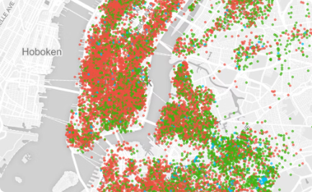


Spatial Analysis
Listing Density
Price Variations
Review Patterns
Hotspots indicate popular neighborhoods for Airbnb rentals.
Pricing likely influenced by location and demand factors.
Review scores may reflect guest experiences across the city.

Slide 9
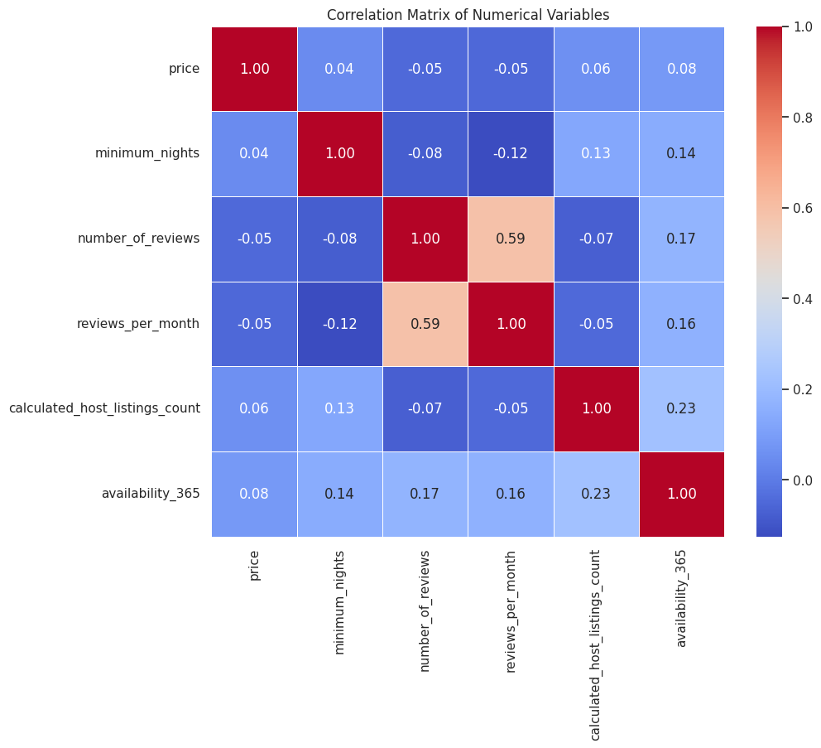
Correlation Analysis
Price Factors
Price has low correlation with other variables, suggesting complex pricing drivers.
Review Metrics
Number of reviews and reviews per month are moderately correlated.
Host Strategies
Hosts with more listings tend to have slightly higher availability.

Slide 10
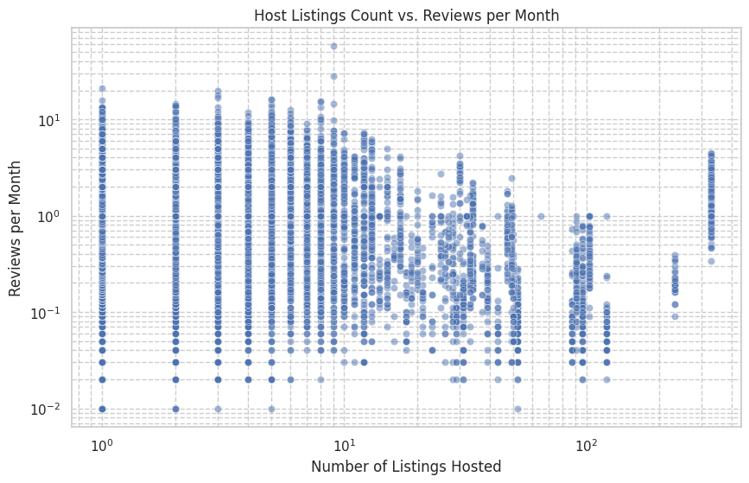



Host Impact
Diverse Strategies
No clear correlation between listings managed and review frequency.
Review Variability
Hosts with many listings have both high and low review rates.
Quality Matters
Guest experience and listing quality may be more important than scale.

Slide 11
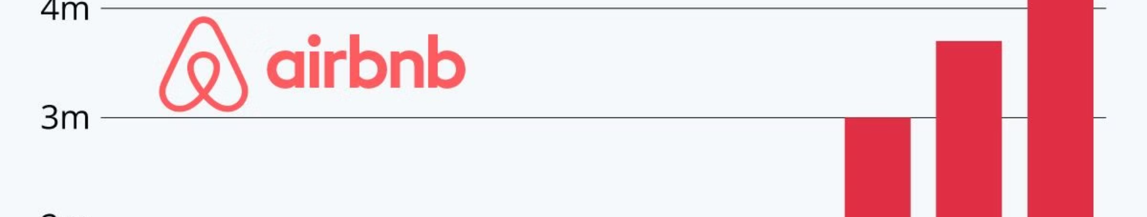



Key Insights
Pricing Dynamics
Popularity Indicators
Host Influence
Room type and location are key drivers of Airbnb pricing.
Reviews reflect varied demand across room types and neighborhoods.
Number of listings managed does not directly correlate with review frequency.

Slide 12
Conclusion
Summary
Recommendations
Through this EDA, key findings related to pricing, popularity, and spatial-temporal trends have been identified, providing a comprehensive understanding of the NYC Airbnb market dynamics.
Based on the insights derived, recommendations will be provided for hosts and guests, leveraging the key findings to optimize property listings and enhance guest experiences within the NYC Airbnb market.

Slide 13

Recommendations or Potential Avenues for Further Analysis
Potential Avenues for Further Analysis
Recommendations
For Hosts:
Adopt dynamic pricing to adjust for peak seasons and high-demand neighborhoods.
Enhance listing quality (photos, amenities) to improve guest attraction and satisfaction.
Encourage guest reviews to boost listing visibility and appeal.
For Guests:
Book during off-peak times for better deals, especially in high-demand areas.
Consider emerging neighborhoods for competitive pricing with good accessibility.
For Policymakers:
Study the impact of short-term rental regulations to balance community and economic interests.
Promote data sharing between platforms and city authorities for informed policymaking.
Regulatory Impact Over Time:
Examine the longitudinal effects of policy changes on the Airbnb market.
External Factors:
Investigate the influence of events, economic shifts, or pandemics on market dynamics.
Comparative City Analysis:
Contrast Airbnb market trends between NYC and other cities to identify unique or common patterns.
Neighborhood Trends:
Conduct detailed analysis of neighborhood-level data to uncover local market insights.
Predictive Market Trends:
Utilize predictive modeling to forecast future pricing, demand, and listing availability trends.
Socioeconomic Effects:
Analyze the broader socioeconomic impacts of Airbnb on communities and housing markets.
Host Economic Impact:
Assess the financial importance of Airbnb income for hosts and explore support mechanisms during downturns.

